Slide 1
Layered Solid Texture Synthesis from a Single 2D Exemplar
Kenshi Takayama¹ Takeo Igarashi^{1,2}
¹The University of Tokyo
²JST/ERATO

Slide 2
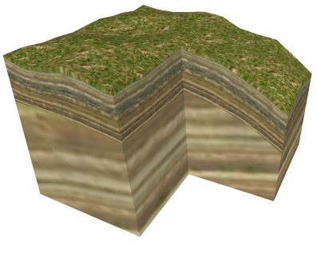
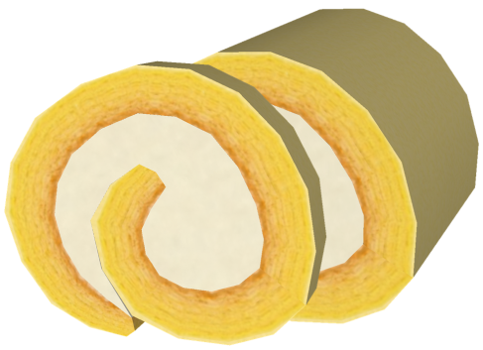
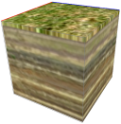
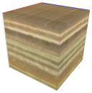
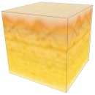
Motivation
Our previous work: Lapped Solid Textures [Takayama et al.2008]
Strata
Cake
Question:
How to create layered solid textures?

Slide 3
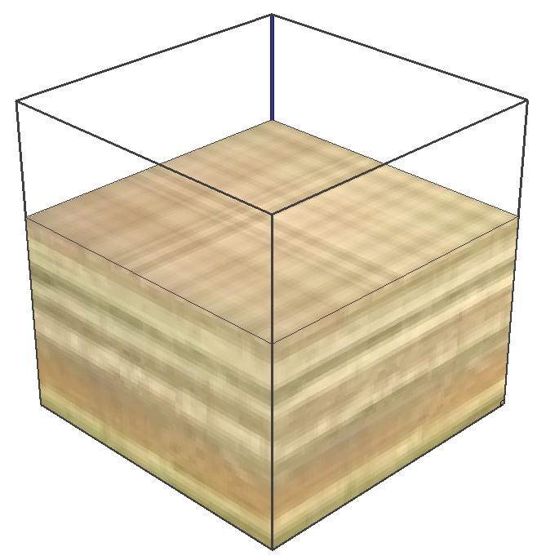
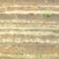
Naïve method [Takayama et al. 2008]
Sweep a 2D image from 2 directions
☹ Cross-hatching artifact
Our proposal: Algorithm for synthesizing layered solid textures from 2D exemplars

Slide 4
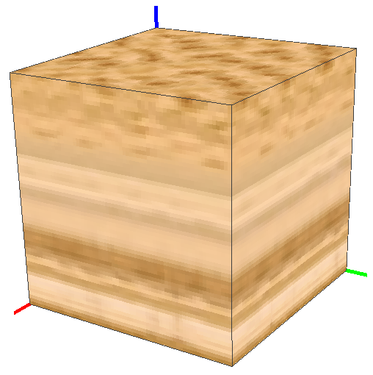
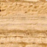
Problem definition
(= depth direction)
Similar
Input:
2D exemplar
Output:
3D solid texture

Slide 5
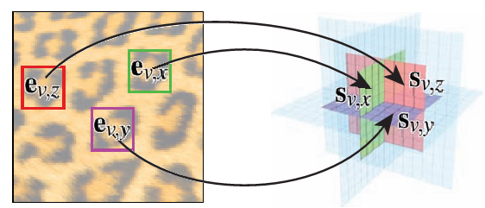
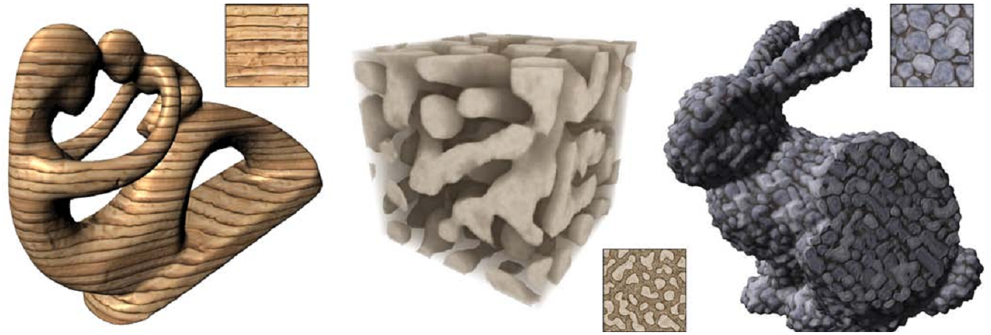
Basic idea
Extend solid synthesis algorithm [Kopf et al. 2007]

Slide 6
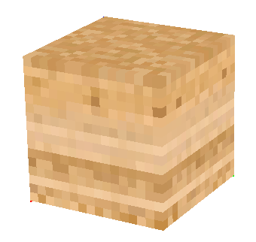
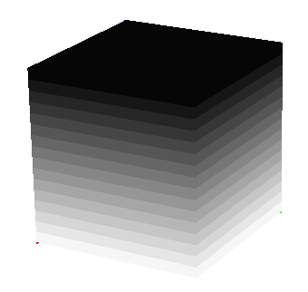

Basic extensions
#1: Layer depth channel
#2: Two-step process (matching & blending) performed only in x- & y-direction
RGB
Depth
RGB
Depth

Slide 7
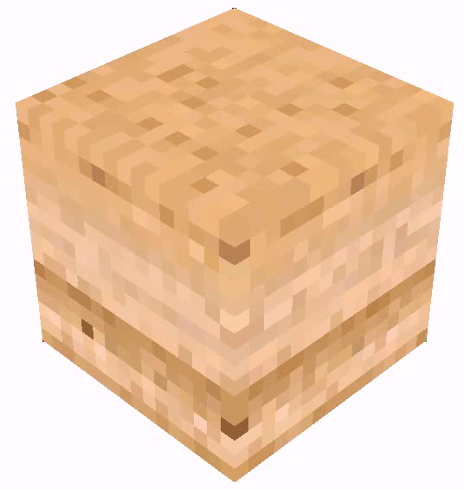
Problem with basic extensions
☹ Sweeping artifact

Slide 8
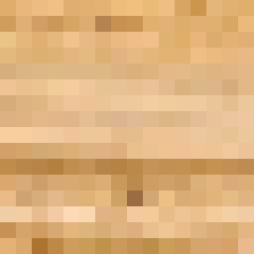
Cause of sweeping artifact
Neighborhoods in x- & y-direction best match to the same neighborhood in 2D exemplar!
Match
Match

Slide 9
Solution to sweeping artifact
Collect two best matching neighborhoods for x- & y-directions
When 1st matches collide,
Select the closer one (y)
Assign 2nd match for the other (x)
Collide!
Match
0.8
1.8
1.5
1.2
0.8
1.8
Select
Match

Slide 10
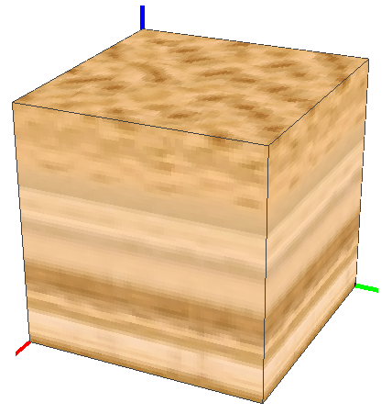
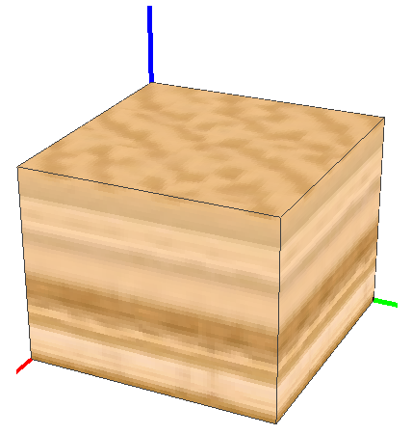
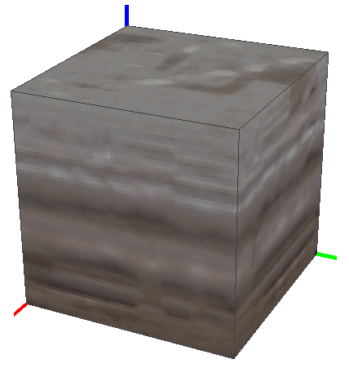
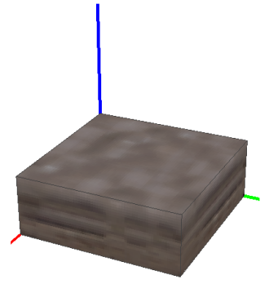
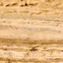
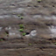
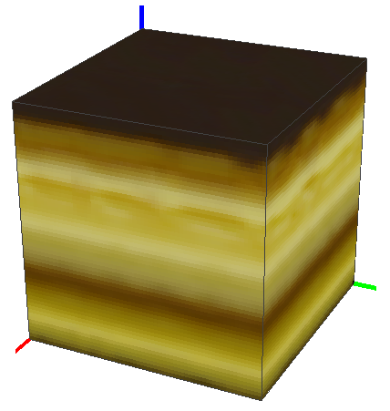
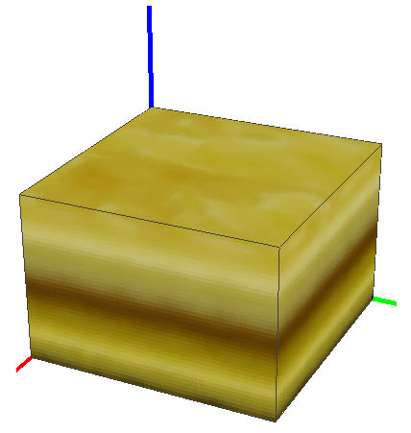
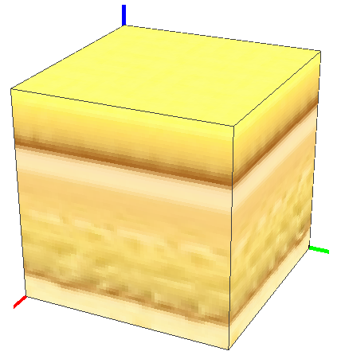
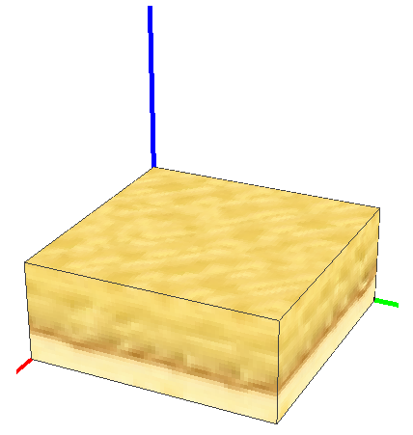
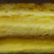
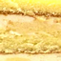
Synthesis results
Works well for many examples!

Slide 11
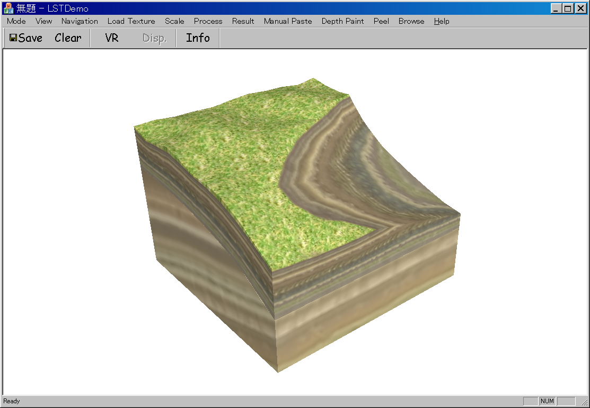
When applied to 3D models

Slide 12
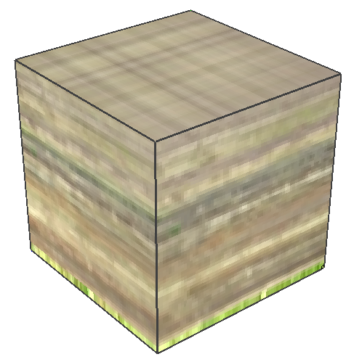
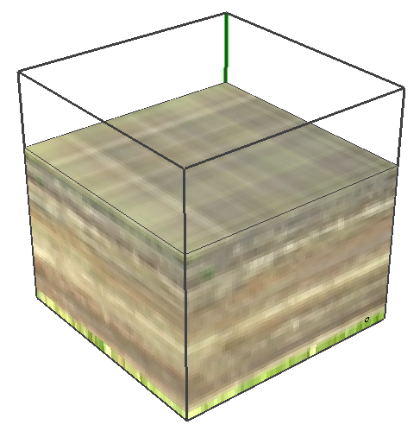
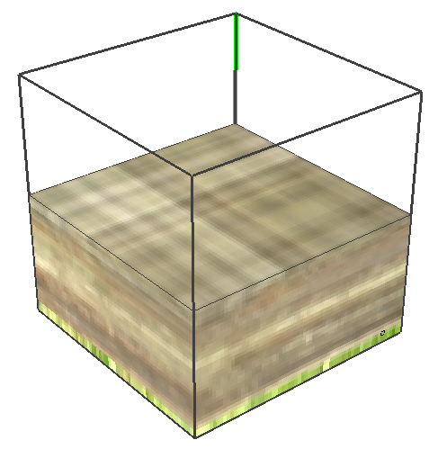
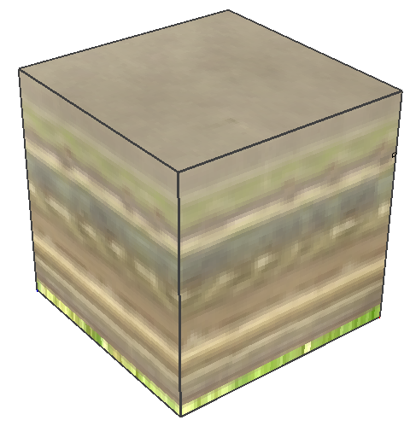
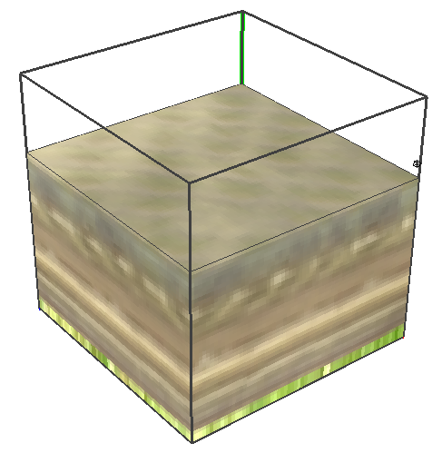
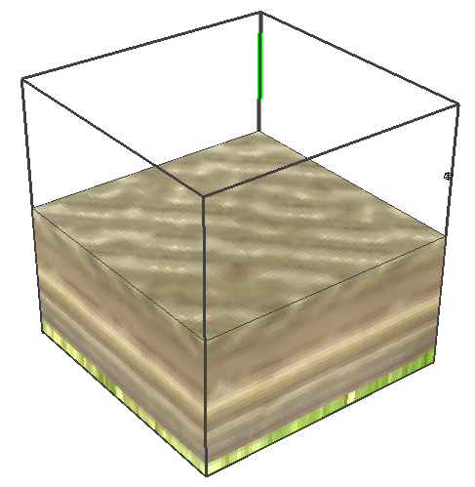
Discussions
☺ “Cross-hatching” much reduced
☹ Strong blur
☹ Directionality still remains
Naïve sweeping
Our synthesis

Slide 13
Thank you!

